Slide 1
Multimedia Systems Lecture – 3
By
Dr. Priyambada Subudhi
Assistant Professor
IIIT Sri City

Slide 2
Multimedia Software Tools
For a concrete appreciation of the current state of multimedia software tools available for carrying out tasks in multimedia.
The following categories of software tools we examine here
Music Sequencing and Notation: e.g. Cakewalk Pro Audio, Finale, Sibelius
Digital Audio: Digital Audio tools deal with accessing and editing the actual sampled sounds that make up audio.
e.g. Adobe Audition, Sound Forge, Pro Tools
Graphics and Image Editing: e.g. Adobe Illustrator, Adobe Photoshop, Adobe Fireworks, Adobe Freehand

Slide 3
Video Editing tools: e.g. Adobe Premiere, CyberLink PowerDirector, Adobe After Effects, Final Cut Pro
Animation:
Multimedia APIs: Java3D, DirectX, OpenGL
Animation Software: Autodesk 3ds Max, Autodesk Softimage, Autodesk Maya
GIF Animation Packages
Multimedia Authoring: Tools that provide the capability for creating a complete multimedia presentation, including interactive user control, are called authoring programs.
E.g. Adobe Flash, Adobe Director, Dreamweaver

Slide 4
Multimedia Systems
A Multimedia System is a system capable of processing multimedia data and applications.
A Multimedia System is characterized by the processing, storage, generation, manipulation and rendition of Multimedia information.

Slide 5
Characteristics of Multimedia Systems
A Multimedia system has four basic characteristics:
Multimedia systems must be computer controlled.
Multimedia systems are integrated.
The information they handle must be represented digitally.
The interface to the final presentation of media is usually interactive.

Slide 6
Challenges for Multimedia Systems
Distributed Networks
Temporal relationship between data
Render different data at same time- continuously.
Sequencing within the media:
playing frames in correct order/time frame in video
Synchronisation- inter-media scheduling
e.g. Video and Audio - Lip synchronization is clearly important for humans to watch playback of video and audio and even animation and audio.

Slide 7
Key Issues for Multimedia Systems
The key issues multimedia systems need to deal with here are:
How to represent and store temporal information.
How to strictly maintain the temporal relationships on play back/retrieval
What process are involved in the above.
Data has to represented digitally- Analog-Digital Conversion, Sampling etc.
Large Data Requirements- bandwidth, storage
Data compression is usually mandatory

Slide 8
Desirable Features for a Multimedia System
Given the above challenges the following feature a desirable (if not a prerequisite) for a Multimedia System:
Very High Processing Power- needed to deal with large data processing and real time delivery of media. Special hardware commonplace.
Multimedia Capable File System- needed to deliver real-time media -e.g. Video/Audio Streaming.
Special Hardware/Software needed - e.g. RAID technology.
Data Representations - File Formats that support multimedia should be easy to handle yet allow for compression/decompression in real-time.

Slide 9
Efficient and High I/O – input and output to the file subsystem needs to be efficient and fast. Needs to allow for real-time recording as well as playback of data. e.g. Direct to Disk recording systems.
Special Operating System - to allow access to file system and process data efficiently and quickly. Needs to support direct transfers to disk, real-time scheduling, fast interrupt processing, I/O streaming etc.
Storage and Memory - large storage units (of the order of hundreds of Tb if not more) and large memory (several Gb or more). Large Caches also required and high speed buses for efficient management.
Network Support - Client-server systems common as distributed systems common.
Software Tools - user friendly tools needed to handle media, design and develop applications, deliver media.

Slide 10
Components of Multimedia Systems
Multimedia systems can be logically grouped into three parts whose primary functionalities are
Content production
Compression and storage
Distribution to various end users and platforms

Slide 11
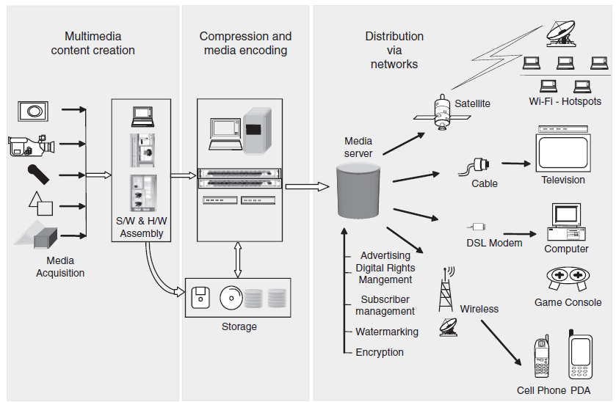
Components of a multimedia system today

Slide 12
Content Production:
It includes a variety of different instruments, which capture different media types in a digital format. These include digital cameras, camcorders or video cameras, sound recording devices, scanners to scan images, and 3D graphical objects.
Once the individual media elements are in their digital representations, they may be further combined to create coherent, interactive presentations using software (S/W) applications and hardware (H/W) elements.
This content can be stored to disk, or in the case of real-time applications, the content can be sent directly to the end user via digital networks.

Slide 13
Compression and Storage:
It deals with the compression of multimedia content
This entails the use of various compression technologies to compress video, audio, graphics, and so on.
Distribution
It deals with media distribution across a variety of low-bandwidth and high-bandwidth networks.
This ranges from cellular, to wireless networks, to cable, to digital subscriber line (DSL), to satellite networks.
Distribution normally follows standards protocols, which are responsible for collating and reliably sending information to end receivers.
The commonly used end receivers are computers, televisions, set-top boxes, cell phones, or even more application- or entertainment-specific items, such as video game consoles.

